Slide 1
DOSE AND DINE: AN IOT-BASED REAL-TIME MEDICINE AND DIET REMINDER SYSTEM

Slide 2
INDEX
Project Description
Problem Statement
Objective
Scope of the Project
Literature Survey
Existing System (with Block Diagram)
Problem Statement
Proposed System
Project Flow Diagram
Hardware and Software Requirements
Functional and Non-Functional Requirements
Future Enhancement
References

Slide 3
PROJECT DESCRIPTION
This IoT-based health reminder system ensures timely medication intake through automated alerts and real-time tracking.
It helps elderly and chronic patients adhere to prescribed medication and meal schedules with remote monitoring features.
The system integrates sensors, microcontrollers, and cloud platforms for efficient health management and caregiver oversight.
It automates medication and dietary reminders, reducing missed doses and fostering better health outcomes.
Through notifications, sensors detect whether medication is taken, logging results in a secure cloud-based system.
The system supports user autonomy while providing caregivers with necessary compliance data for timely interventions.

Slide 4
PROBLEM STATEMENT
Medication non-adherence among elderly or chronically ill patients leads to serious health complications and treatment failures.
People often forget medication and meal schedules, especially those with memory impairments or complex health regimens.
Current reminder systems lack real-time adherence tracking and caregiver oversight, making intervention difficult in critical situations.
Manual tracking of medication and dietary compliance is tedious, error-prone, and fails to provide actionable insights.
Existing systems do not integrate sensors to detect medication intake or provide feedback to users or caregivers.
A lack of secure and user-friendly solutions limits effective health management and timely response to missed doses.

Slide 5
OBJECTIVE
To develop an IoT-based health reminder system for automated medication and meal scheduling with adherence tracking.
To integrate real-time notifications and sensor-based adherence logging to ensure compliance and prevent missed doses.
To provide caregivers with remote monitoring capabilities for better health management of patients in need.
To create a customizable scheduling system adaptable to various health conditions, with user-friendly interfaces.
To minimize medication and dietary non-adherence, improving long-term health outcomes for patients.
To ensure the system is reliable, secure, and scalable for diverse patient populations with chronic conditions.

Slide 6
SCOPE OF THE PROJECT
The system focuses on automating medication reminders and tracking dietary adherence using real-time notifications.
It integrates sensors and microcontrollers to track user actions like medication intake and meal consumption.
Cloud connectivity allows remote access for caregivers, enabling real-time monitoring of patient adherence records.
The project targets elderly patients and individuals with chronic conditions requiring strict health management.
The system's scalability allows for customization based on individual health needs and medication schedules.
It aims to reduce reliance on caregivers by promoting user independence and enhancing adherence.

Slide 7
LITERATURE SURVEY
S. NO | TITLE | AUTHOR | YEAR& PUBLICATION | DRAWBACKS | DESCRIPTION
1 | Intelligent and Safe Medication Box In Health IoT Platform for Medication Monitoring System with Timely Remainders | B. Ayshwarya and R. Velmurugan | 2021, 7th International Conference | Limited scalability, high implementation cost, lack of universal standards | Discusses an IoT-based medication box for monitoring medication usage with timely reminders, improving adherence and safety.
2 | Enhanced Medication Reminder and Alert System using IoT | P. A. Mathina, K. Valarmathi, K. Ramalakshmi, S. Bharathi, R. Deepika, and M. Dharshini | 2023, 8th International Conference on Communication and Electronics Systems (ICCES), Coimbatore, India | Potential connectivity issues, privacy concerns | Introduces an IoT-based medication reminder and alert system that helps users manage their medication schedules effectively.

Slide 8
3 | IoT-Based Real-Time Medicine Reminder and Tracking System | Sangameshwar Kawdi, Preeti, Namratha, Vijay Laxmi | 2024, International Research Journal of Engineering and Technology (IRJET), Volume 11, Issue 02 | Limited to specific medicine tracking, dependency on device availability | Presents a real-time IoT-based system for medicine reminders and tracking, aimed at improving medication adherence.
4 | IoT-Based Pill Reminder and Monitoring System | Sultan Ahmad, Mahamudul Hasan, Gouse Pasha Mohammed, Mohammad Shahabuddin, Tasnia Tabassum, and Mustafa Wasif Allv | 2020, IJCSNS International Journal of Computer Science and Network Security, vol. 20, no. 7 | Issues with long-term battery life and system complexity | Describes an IoT-based pill reminder and monitoring system for tracking medication intake and enhancing user compliance.
5 | Medicinal Cannabis and Implications for Workplace Health and Safety: Scoping Review of Systematic Reviews | V. O'Neill, N. Karanikas, A. Sav, and P. Murphy | 2023, Workplace Health & Safety, vol. 71, no. 9 | Focus on limited health areas, lack of specific IoT integration | Reviews the implications of medicinal cannabis use in the workplace, particularly concerning health and safety.

Slide 9
EXISTING SYSTEM
Existing systems offer basic reminders but lack advanced tracking of medication or dietary compliance.
Most solutions provide simple text or audio reminders without sensor integration for adherence tracking.
Current systems often fail to offer cloud-based monitoring for caregivers or provide real-time updates.
Limited or no integration with mobile applications or web-based interfaces hampers remote monitoring.
A lack of customization options makes it challenging to address the unique needs of each user.
Existing systems typically have limited data security, raising concerns over privacy and unauthorized access.

Slide 10
EXISTING SYSTEM BLOCK DIAGRAM
POWER SUPPLY UNIT
Controller
RTC MODULE
LCD Display
BUZZER
LED

Slide 11
PROBLEM STATEMENT
Medication non-adherence among elderly or chronically ill patients leads to serious health complications and treatment failures.
People often forget medication and meal schedules, especially those with memory impairments or complex health regimens.
Current reminder systems lack real-time adherence tracking and caregiver oversight, making intervention difficult in critical situations.
Manual tracking of medication and dietary compliance is tedious, error-prone, and fails to provide actionable insights.
Existing systems do not integrate sensors to detect medication intake or provide feedback to users or caregivers.
A lack of secure and user-friendly solutions limits effective health management and timely response to missed doses.

Slide 12
PROPOSED SYSTEM
The system integrates IoT technology to automate medication and meal reminders through visual and audible notifications.
It utilizes sensors to detect medication intake, automatically logging adherence as "Taken" or "Missed."
Cloud-based platforms enable remote caregiver monitoring, offering real-time adherence insights and intervention capabilities.
The system is highly customizable, allowing users and caregivers to adjust reminder schedules as needed.
Enhanced data encryption and user authentication ensure secure transmission and privacy protection of health records.
Real-time adherence data enables caregivers to take timely actions, improving overall health outcomes and compliance.

Slide 13
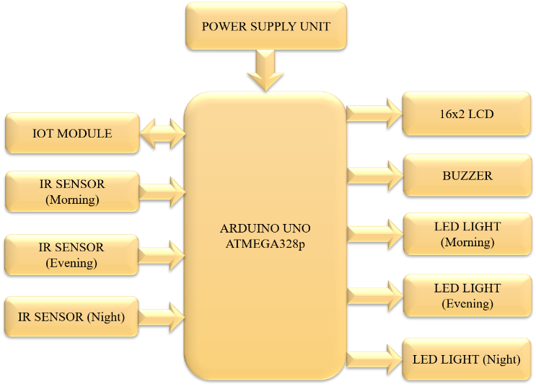
BLOCK DIAGRAM

Slide 14
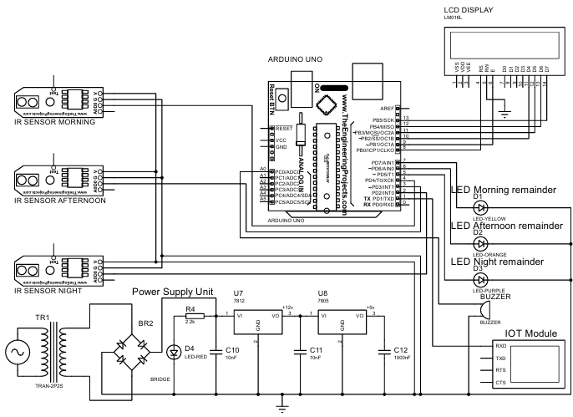
CIRCUIT DIAGRAM

Slide 15
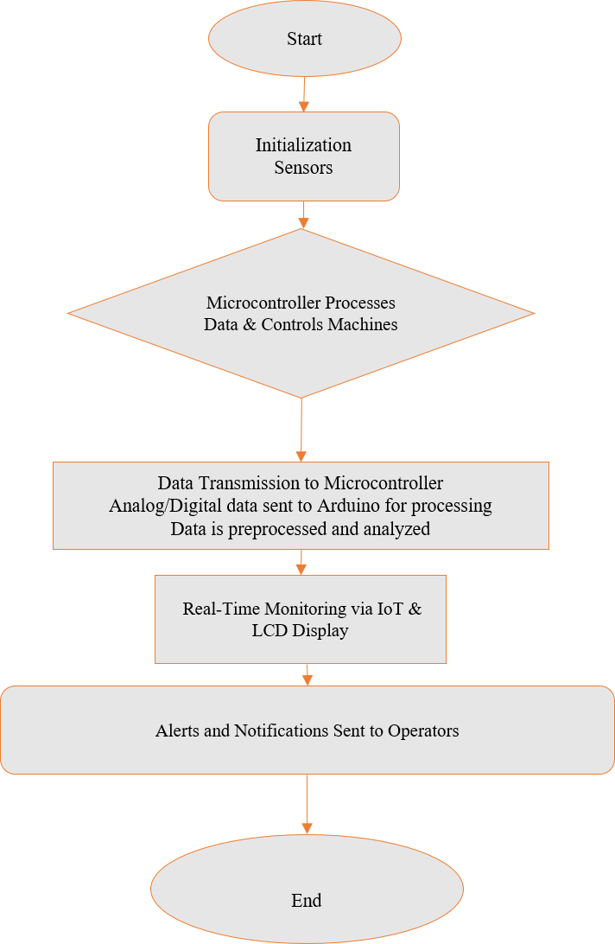
FLOW DIAGRAM

Slide 16
HARDWARE AND SOFTWARE REQUIREMENTS
MC Programming Language : Embedded C
Programming tool : Arduino IDE
Arduino Uno
Node MCU
IR sensor
Lcd Display
Led
Buzzer

Slide 17
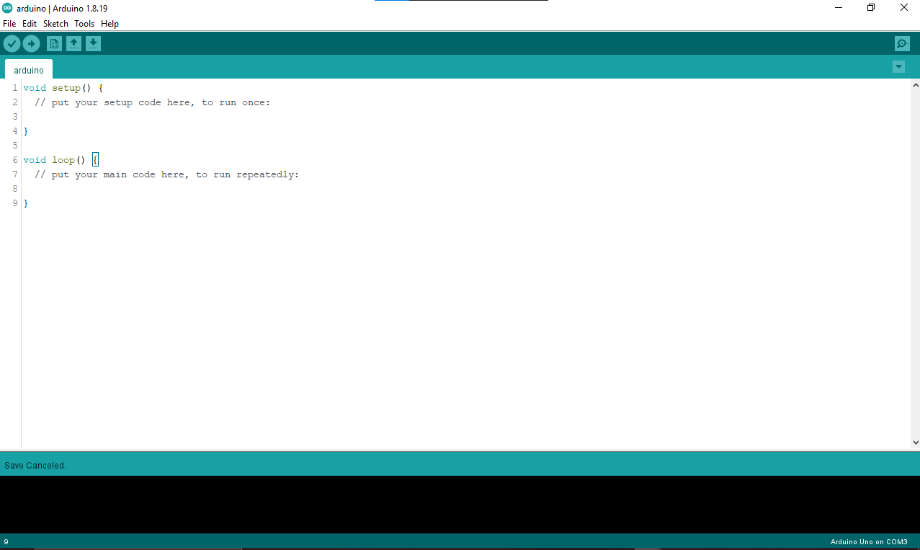
ARDUINO IDE:
The Arduino IDE (Integrated Development Environment) is an open-source software used for writing, compiling, and uploading code to Arduino microcontrollers. It supports C/C++ programming languages and provides a simple interface for creating and testing Arduino projects, known as "sketches." The IDE features syntax highlighting, error checking, and access to a vast library of pre-written code for various sensors and peripherals. It is widely used by hobbyists, students, and professionals for rapid prototyping and embedded system development.

Slide 18
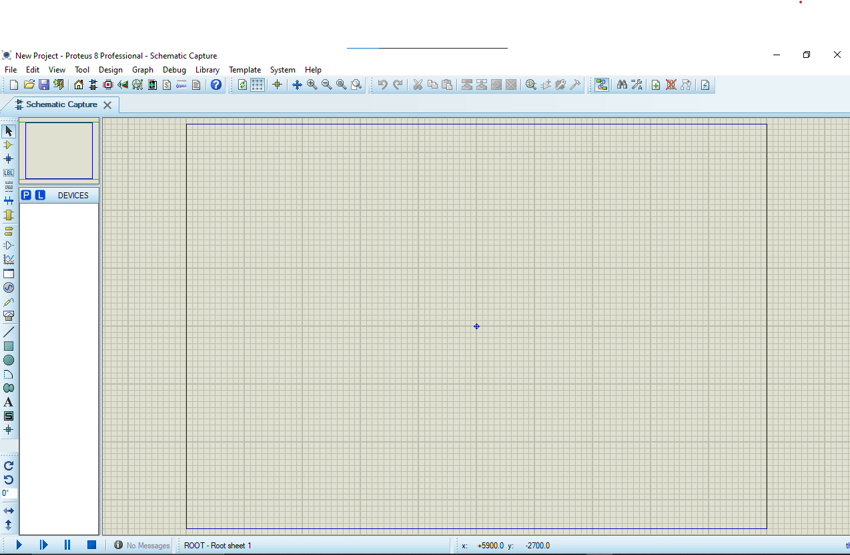
PROTEUS:
Proteus is a simulation and design software used to create and test electronic circuits. It allows users to design circuits with components like microcontrollers, sensors, and displays, and simulate their behavior before building a physical prototype. Proteus supports simulation of microcontrollers such as Arduino, PIC, and 8051, providing a visual interface for wiring and component placement. The software is commonly used in education and industry for designing, testing, and debugging embedded systems and electronic circuits in a virtual environment.

Slide 19
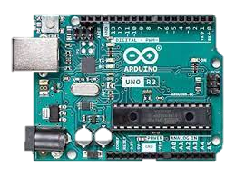
ARDUINO(ATMEGA832P)
Arduino is a little board that lets you make things like lights, robots, and gadgets. You tell it what to do by writing simple instructions, and it makes things happen, like turning on a light when you press a button. It's easy to use and great for anyone who wants to build fun projects.

Slide 20
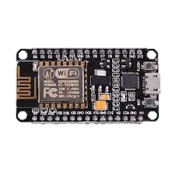
NODE MCU
NodeMCU is a low-cost, open-source platform that combines a microcontroller with built-in Wi-Fi, making it perfect for IoT (Internet of Things) projects. It's based on the ESP8266 chip, which means it can connect to the internet and control things remotely.

Slide 21
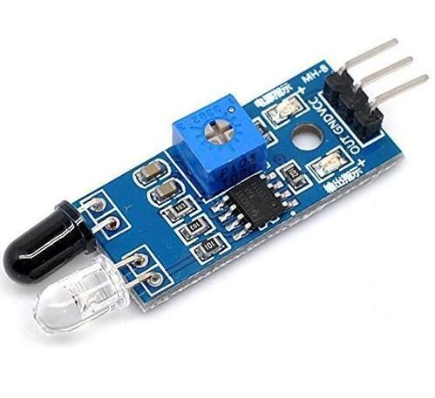
IR SENSOR
An IR (Infrared) sensor is a device that uses infrared light to detect objects, measure distance, or sense movement. It emits infrared radiation, which is invisible to the human eye, and then measures the reflection of this radiation from nearby objects.

Slide 22
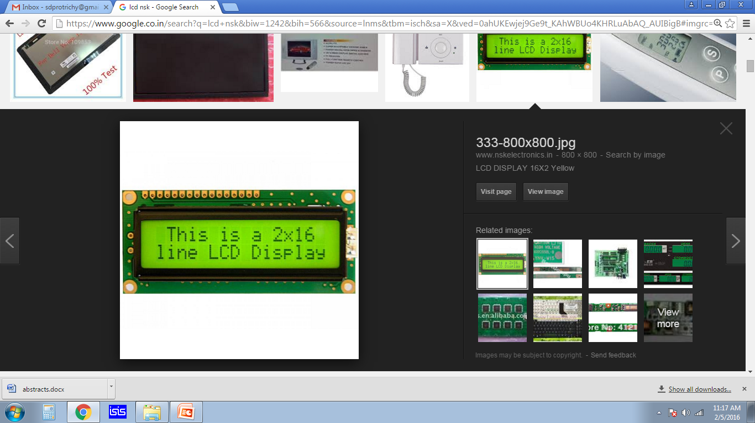
16x2 LCD DISPLAY
A liquid-crystal display (LCD) is a flat-panel display or other electronic visual display that uses the light-modulating properties of liquid crystals.
Liquid crystals do not emit light directly.

Slide 23
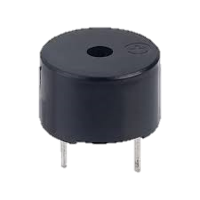
BUZZER
A buzzer is a device that produces sound, often used in electronic circuits to provide audio feedback or alerts. It works by generating vibrations or oscillations that create sound waves.

Slide 24
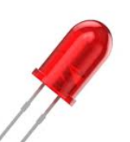
LED
An LED (Light Emitting Diode) is a semiconductor light source that emits light when an electric current passes through it. Unlike traditional bulbs, LEDs are energy-efficient, durable, and have a long lifespan. They produce light in various colors, are used in a wide range of applications, and generate minimal heat compared to incandescent lighting.

Slide 25
FUNCTIONAL AND NON-FUNCTIONAL REQUIREMENTS
The system must ensure accurate detection of medication intake using infrared sensors to monitor adherence.
It must provide customizable scheduling for medication reminders and dietary alerts to suit user needs.
The system should transmit adherence data to a cloud platform for caregiver monitoring via web or app.
Notifications must be both visual (LED) and audible (buzzer) to ensure that all users are alerted.
The system must allow secure access to health data through encrypted communication and authentication.
The system should be reliable, with minimal delays between reminders and actual notifications or actions.

Slide 26
FUTURE ENHANCEMENT
Incorporating machine learning for predictive analytics to optimize medication schedules based on adherence trends.
Integrating voice recognition to enable hands-free operation for users with limited mobility or vision.
Expanding compatibility to include integration with other health devices like glucose meters or blood pressure monitors.
Implementing multi-language support for diverse user populations, improving accessibility and usability.
Enhancing AI-driven recommendations for personalized health tips based on patient data and behavior.
Incorporating emergency alerts for critical health changes, enabling caregivers to respond promptly.

Slide 27
REFERENCES
B. Ayshwarya and R. Velmurugan, "Intelligent and Safe Medication Box In Health IoT Platform for Medication Monitoring System with Timely Remainders," 2021 7th International Conference .
P. A. Mathina, K. Valarmathi, K. Ramalakshmi, S. Bharathi, R. Deepika and M. Dharshini, "Enhanced Medication Reminder and Alert System using IoT," 2023 8th International Conference on Communication and Electronics Systems (ICCES), Coimbatore, India.
Sangameshwar Kawdi, Preeti, Namratha, Vijay Laxmi, "IOT-Based Real Time Medicine Reminder and Tracking System", International Research Journal of Engineering and Technology (IRJET), Volume: 11 Issue: 02 Feb 2024.
Sultan Ahmad, Mahamudul Hasan, Gouse Pasha Mohammed, Mohammad Shahabuddin, Tasnia Tabassum and Mustafa Wasif Allv, “IoT based Pill Remainder and Monitoring System”, IJCSNS International Journal of Computer Science and Network Security, vol. 20, no. 7, July 2020.
V O‘Neill, N Karanikas, A Sav and P. Murphy, "Medicinal cannabis and implications for workplace health and safety: scoping review of systematic reviews", Workplace Health & Safety, vol. 71, no. 9, pp. 400-10, Sep 2023.

